Slide 1

Machine Learning
Summer Internship- 2026
Name: Kanak
Supervisor: Prof. Millie Pant
Mentor: Ms. Riya Applied Mathematics & Scientific Computing
Indian Institute of Technology Roorkee
Joined Date:9-June-2026

Slide 2

Table of Content
Introduction to machine learning
Data Preprocessing & EDA
Linear & Logistic Regression
Decision Trees & Random Forests
SVM & K-Nearest Neighbors
Clustering & Dimensionality Reduction
Model Evaluation & Hyperparameter Tuning
Feature Engineering
Introduction to NLP
1

Slide 3
Introduction to Machine Learning
What is Machine Learning?
A branch of AI that enables systems to learn from data and improve without being explicitly programmed.
Ex –
You Tube recommendations - Learn from watch history
Spam Detection in Gmail – Learns Patterns in spam emails
Types of Machine Learning:-
1. Supervised Learning
2. Unsupervised Learning
Here also we will get the data but we are not going to predict anything. We will just find patterns, group similar items.
We give the machine input and the correct answers and it learns to predict. In short, we can say we have both input and output variables.
3. Reinforcement Learning
Reinforcement Learning is like training a dog. You don’t teach it everything directly-
instead, You reward good behavior and ignore or punish bad actions. Over time, the learns what actions give it treats That’s the core idea of Reinforcement Learning – learning by trial and error
2

Slide 4
ML Workflow and Handling Missing Values
1.Problem Definition
2.Data Collection
3.EDA & Preprocessing
4.Feature Engineering
5.Model Training
6.Evaluation
7.Tuning
8.Deploy
Define task
Gather labelled/
unlabeled data
Clean, transform, visualise
Create & select features
Fit algorithm to training data
Measure performance on test set
Optimise hyperparameters
Serve model in production
What are Missing Values?
Missing values are empty or unavailable data in a dataset.
We can handle them in two ways:-
1. Dropna() Method:-
Removes rows or columns containing missing values. Used when the amount of missing data is small.
Syntax:
df.dropna() # drop any row with NaN
df.dropna(subset=['col']) # only where specific col is NaN
2. Fillna() Method:-
Replaces missing values instead of removing them. Helps preserve all rows in the dataset.
Syntax:-
df.fillna(value)
3

Slide 5
Encoding Categorical Variables, Feature Scaling and EDA
Label Encoder(ordinal encoding):- It converts each unique text category onto a unique sequential integer(i.e. 0,1,2).
One-Hot Encoder(Nominal Encoding):- It converts a single categorical column into multiple binary columns(0 or 1),creating a new column for every unique category
Feature Scaling:- It is the process of converting features into a similar range so that no feature dominates other because of its largest values.
Standard Scalar(standardization):- It is a feature scaling technique that transforms data so that it has a mean of 0 and a standard deviation of 1.
MinMaxScaler(Normalization):- It scales features to specified range typically [0,1], by using the minimum and maximum values of the features.
Exploratory Data Analysis:- Understand your data visually before building any model.
Histograms — Shows the distribution of Numerical values
Scatter plots — relationship between 2 numeric features
Count / bar plots — shows the count of categorical values.
4

Slide 6
Linear Regression And Logistic Regression
It is supervised machine learning algorithms used to predict a continuous value by finding the best-fit line between input features and output.
Cost Function:- A cost function measures how much error exists between the predicted values and the actual values.
Gradient Descent:- Gradient descent is an optimized algorithm used to minimize the cost function by updating the model parameters.
Logistic Regression:- Logistic Regression is a supervised machine learning algorithm used for binary classification, where the output has only two class: 1-Yes and 0-No
Metrics
RMSE(Root Mean Squared Error) = √MSE (RMSE is the square root of MSE)
MSE(Mean Squared Error):- MSE measures the average of squared differences between actual and predicted values.
R² score:-It tells how well the model explains the data.
Accuracy:- Percentage of correct predictions.
Confusion Matrix:-
TP(True Positive): Predicted positive, actually positive
TN(True Negative): Predicted negative, actually negative
FP(False Positive):Type I error — predicted +, actually −
FN(False Negative): Type II error — predicted −, actually +
5

Slide 7
Decision Trees, Random Forest
It predicts the output by asking a series of questions about the input features.
Gini Impurity: It measures how mixed the classes are in a dataset.
Entropy: If measures the amount of uncertainity or disorder in the data.
Info Gain = It measures how much uncertainity is reduced after splitting the data.
Overfitting:- Overfitting happens when a ML model memorize the training data instead of learning general patterns. To prevent overfitting, tree pruning method is used.
Pruning:- Pruning means cutting unnecessary branches from a decision tree to make it simples.
Max_depth:- It is a parameter that limits how deep a decision tree can grow. It specifies the maximum number of levels allowed in a decision tree.
Random Forest:- A Random Forest is a machine learning algorithm that combines the predictions of multiple decision trees to create a more accurate and stable final answer.
6

Slide 8
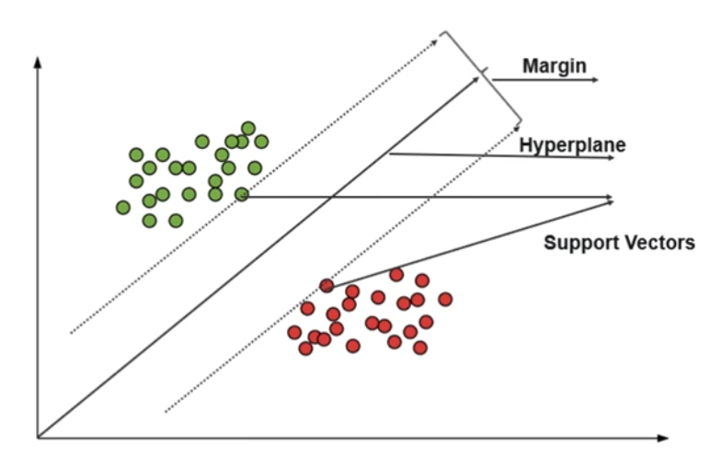
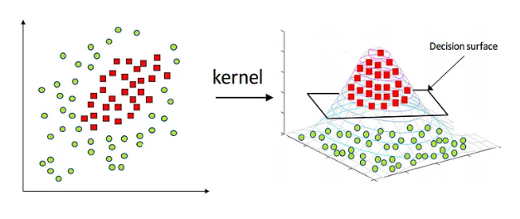
SVM: Hyperplane, Margin & Kernel Trick
Support Vector Machine:- It finds the best boundary(hyperplane) that seperates different classes/categories.
Hyperplane:- A hyperplane is the decision boundary that seperates different classes.
Margin:- The margin is the distance between the hyperplane and the nearest data points from both classes.
Support Vectors:- Support vectors are the data points closest to the hyperplane.
Kernel Trick:- It is technique used in SVM to transform non-linearly seperable data into a higher –dimensional space, allowing it to be separately by a hyperplane without explicity computing the transformation.
7

Slide 9
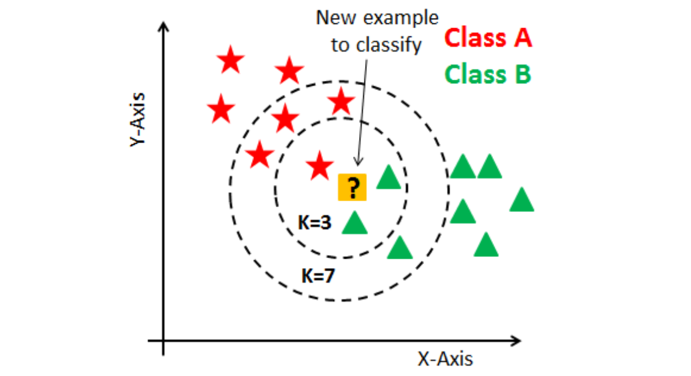
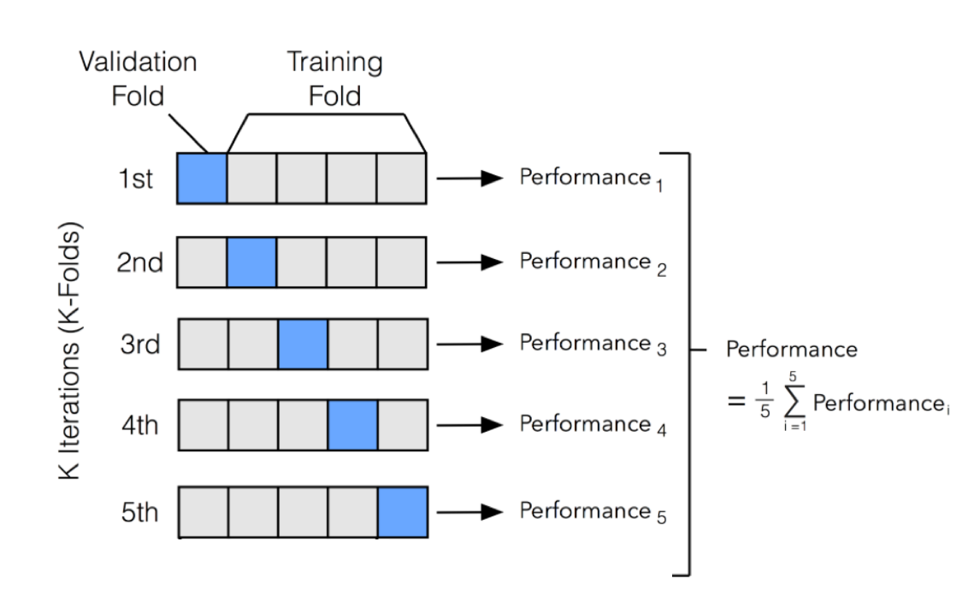
KNN And Cross Validation
K-Nearest Neighbors :-It a supervised ML algorithm used to predicts the class of a new data point based on the K-nearest(closest) data points.
Distance Metrics:- A distance metric is a formula used to measure how close two points are:
1. Euclidean distance:-It is the straight line distance between two points.
d = √Σ(xᵢ−yᵢ)
Cross Validation:-Cross-validation is a technique used to evaluate how well a machine learning model will generalize to new, unseen data. Instead of relying on a single train-test split, cross-validation systematically tests the model on multiple different subsets of the data and averages the results.
K-Fold Cross Validation:-
8

Slide 10
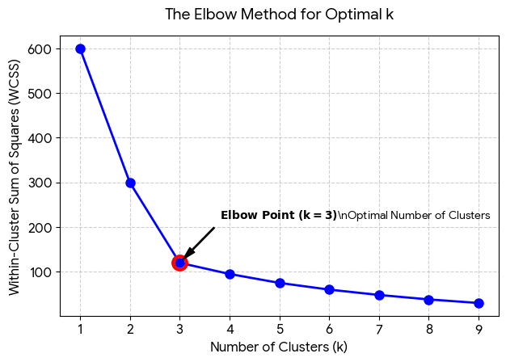
K-Means Clustering
K-Means is an unsupervised machine learning algorithm that groups similar data points into K clusters based on their similarity. To decide the value of K we use elbow method:
Elbow Method:-
Centroids:-A centroid is the center point of a cluster. It is calculated as the average of all data points in that cluster.
Inertia:-Inertia is the sum of the squared distances between each data point and its nearest centroid.
WCSS- Within cluster sum of squared distance
DBSCAN(Density-Based Spatial Clustering of Applications with Noise):- DBSCAN is a machine learning algorithm that groups data points based on density. It has no need to guess K.
PCA(Principal Component Analysis):- PCA is a widely used unsupervised dimensionality reduction technique.
Principle Components:-
PC1(Principal Components 1): The best possible angle captures the most variation in the data.
PC2(Principal Components 2): The second-best angle, completely independent of PC1.
9

Slide 11
GridSearchCV & RandomizedSearchCV
GridSearchCV:- You give the computer a “Grid”(a list of all the knob settings you want to try). The computer will exhaustively try every single possible combination using cross-validation, and tell you which combination had the best score.
RandomizedSearchCV:- Instead of trying every combination, you give it the same lists, but tell it: “Just Pick random combinations and try them , and stop after 50 tries.”
Metrices:-
Accuracy = (TP+TN)/(TP+TN+FP+FN) — Percentage of correct predictions.
Precision = TP/(TP+FP) —Out of all positive values, how many of them are actual true positive.
Recall = TP/(TP+FN) — Out of all actual true positive, how many have been predicted correctly .
F1-Score = 2·P·R/(P+R) — Balance between correct and incorrect predictions. It is the Harmonic mean of precision and recall.
ROC Curve: Stands for Receiver Operating Characteristic. It plots the True Positive Rate (TPR) against the False Positive Rate (FPR) at varying threshold levels
AUC Score: Stands for Area Under the Curve. It quantifies the entire two-dimensional area underneath the entire ROC curve, ranging from 0.0 to 1.0.
10

Slide 12
Feature Selection: SelectKBest, RFE & Correlation
Feature Selection:- It is the process of choosing only the most relevant features to train your model.
Correlation:- Correlation measures how strongly two variables are related. It ranges from 1 to -1.
r=1: perfect positive correlation( both go up together).
r=-1: perfect negative correlation( one goes up, the other goes down).
r=0: No linear relationship at all.
SelectKBest:- This is an automated tool that scores all your features against the target and simply keeps the “K” best ones. If you say K=5, it keeps the top 5 highest-scoring features.
RFE(Recursive Feature Elimination):- Instead of testing features one by one, it tests them all together inside a model, finds the weakest link, kicks it out, and repeats the process until only the best features are left.
Creating New Features:-We have to mathematically combine them to create new features that help the model see the hidden patterns.
Polynomial Features:-Polynomial features create curves by squaring or cubing your existing features.
Interaction Features:-Multiplying or combining two completely different columns together.
11

Slide 13
Introduction to NLP
NLP stands for Natural Language Processing. It is a subfield of artificial intelligence (AI) that gives computers the ability to understand, interpret, and manipulate human language (like English, Hindi, or Spanish) just like humans do.
Tokenization:- It is the process of breaking down a large paragraph of text into smaller, individual pieces called tokens.
Raw Text:-”I Love Machine learning”
Tokens:- [“I” , “Love” , “Machine” , “Learning”]
Stopwords Removal:- There are words that appear very frequently but carry almost no actual meaning. These are called stopwords. Removing them helps the computer focus on the important words.
Before: [“The” , “Movie” ,“is” ,“good” ]
After: [ “Movie” ,“good” ]
Stemming:- Reducing words to their base or root form (e.g., "running", "ran", and "runs" all get shortened to "run").
Bag of Words:- It completely ignores grammar and word order: it only cares about frequency.
Sentence1: “Love machine learning”
Sentence2: “love love coding”
Sentence1 Vector: [1, 1, 1, 0](1 ‘love’, 1’machine’, 1 ‘learning’,0 ‘coding’)
Sentence1 Vector: [2, 0, 0, 1](1 ‘love’, 1’machine’, 1 ‘learning’,0 ‘coding’)
TF-IDF(Term Frequency-Inverse Document Frequency):-
Term Frequency:-Measures how often a word appears in a single document.
Inverse Document Frequency:-Measures how common or rare a word is across the entire collection of documents
12

Slide 14
References & Further Reading
Core Textbooks
Géron, A. (2022). Hands-On Machine Learning with Scikit-Learn, Keras & TensorFlow (3rd ed.). O'Reilly Media.
Google ML Crash Course — Machine Learning | Google for Developers
Scikit-learn Getting Started — Getting Started — scikit-learn 1.9.0 documentation
Kaggle Datasets — https://www.kaggle.com/datasets
Kaggle – Natural Language Processing with Disaster Tweets | Kaggle
13

